Slide 1
15-19 November 2018, Bangladesh

Slide 2
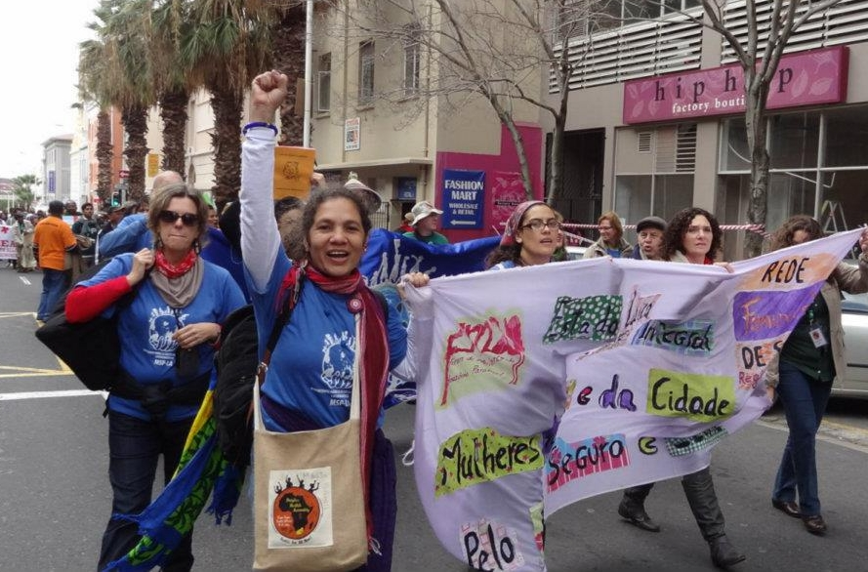
4th People’s Health Assembly – PHA4
Drawing on civil society organizations and networks, social movements, academia and other actors from around the globe, PHA4 will provide a unique space for
strengthening solidarity,
sharing experiences,
mutual learning and
joint strategizing for future actions
STRENGTHENING OUR MOVEMENT
To plan & strategise action together

Slide 3
Expected outcomes
Discussions and debates in the Assembly, will provide guidance and direction to PHM to conduct a range of activities. These include given new impetus
to PHM’s Global Health for All Campaign,
to PHM’s policy dialogues and interventions to strengthen health systems,
to activities that address the social determination of health
and to the PHM’s global initiative on ‘Democratising Governance for Health’.
It is expected that, through the various debates, the Assembly’s exchanges and collective strategizing will enhance PHM’s capacity to organize and mobilize for health.
Concrete actions and medium and long term plans are expected to emerge from the deliberations of the Assembly in major thematic and program areas.

Slide 4
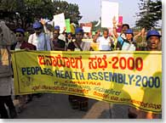
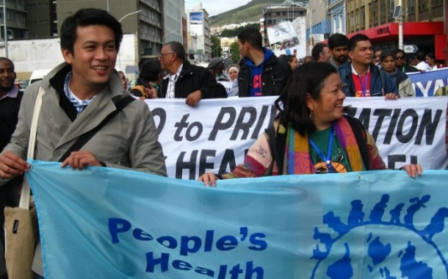
PHA1 – PHA2 – PHA3
PHA1 , 2000 , Bangladesh, Savar
No “Health for All by 2000” – need for a people’s movement!
Birth of People’s Health Movement and People’s Charter for Health
PHA2, 2005, Ecuador, Cuenca
The Cuenca Declaration adopted – strategic vision for PHM
PHA3, 2012, South Afria, Cape Town
The Cape Town Declaration – action orientated

Slide 5
Thematic axes
Axis 1:
The political and economic landscape of development and health
Axis 2:
Social and physical environments that destroy or promote health
Axis 3:
Strengthening health systems to make them just, accountable, comprehensive, integrated and networked
Axis 4:
Organizing and mobilizing yet again for Health for All

Slide 6
Structure of PHA4
Plenary sessions: Plenary session on each day will focus on the major themes of the Assembly. Each plenary will include: testimonies, key-note speeches and space for open discussion. An additional plenary session on the last day will debate and finalize the Assembly's Declaration.
Sub-plenary sessions: each plenary will be followed by 4-6 concurrent sub-plenary sessions designed to further deepen the discussions on each of the thematic axes.
Self-organized events: space will be provided for civil society organizations/networks and other participating groups to organize workshops on topics related to their own priorities within the framework of the Assembly themes

Slide 7
Regional and Thematic discussions
In addition the program will provide spaces on a daily base for
regional discussions: to set priorities and plan action within the regions
Thematic discussions: to strategise and plan global coordinated action on
Health systems, against privatisation, defence of public systems, etc.
Food and Nutrition and Food Sovereignty
Trade and Health + Access to Medicines
Gender and Health
Environment, Extractive Industries, and Development

Slide 8
Mobilising for PHA4 – what can we do?
Each region and/or circle can prepare for the assembly in a way relevant for the region/circle.
This can include
Preparing for the regional discussions that will take place at PHA4
Identifying opportunities for taking action for example around the 5 themes suggested at PHA3
Health systems, against privatisation, defense of public systems, etc.
Food and Nutrition and Food Sovereignty
Trade and Health + Access to Medicines
Gender and Health
Environment, Extractive Industries, and Development

Slide 9
Mobilising for PHA4 – what can we do?
Identifying creative ways how the PHM programs can support regional and local action taken
IPHU
GHW
WHO watch
Identifying opportunities for the region to continue discussions in the lead up and following PHA4

